Slide 1
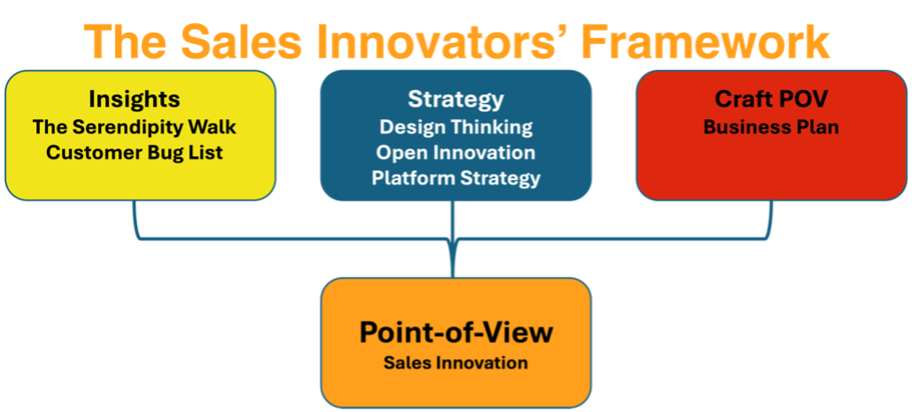

Slide 2
The Business Plan

Slide 3
Working slides for your project
Slides marked yellow can be used for the final presentation. Keep it short and punchy – max 10 min. It’s ok if you want to use a different format e.g. video, prezi, etc.
Slides marked orange can be used as a skeleton framework to prepare your idea.

Slide 4
Use these templates for your final presentation (delete this when presenting)
Your title
Hint: Give your business plan a compelling name that makes an impact. You need to convince your audience.

Slide 5
Business Opportunity Name:
Use these templates for your final presentation (delete this when presenting)
________________________________________________________________________________________
The Market Problem:
Competitors:
Your idea:
Sales & Marketing plan:
Target Market:
Milestones:
Hint: Summarise your idea and research into a short punchy presentation – no more than 10 min

Slide 6
Team
Use these templates for your final presentation (delete this when presenting)
Team:
What else can add value (innovation)?
Financials:
Hint: Summarise your idea and research into a short punchy presentation – no more than 10 min

Slide 7
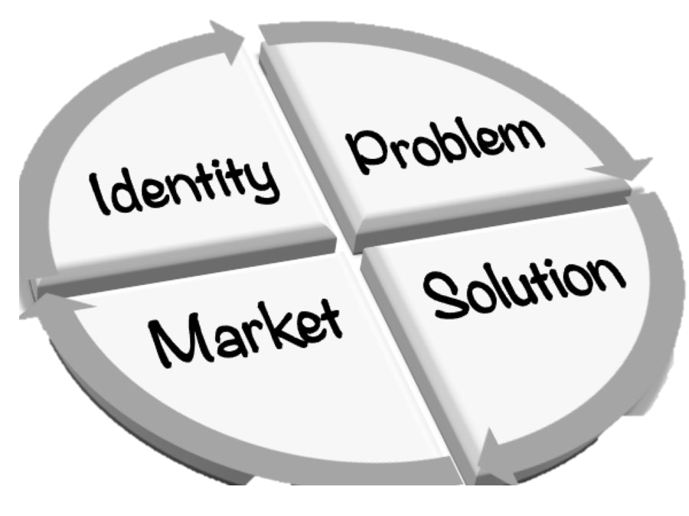
Use these templates for your final presentation (delete this when presenting)
Business Opportunity Name:
___________________________________________
The Market Problem:
What do customers want that they are not getting elsewhere?
Description:
Hint: Use the innovation framework to (proposition 1) identify needs that are not being met OR (proposition 2) identify improvements.

Slide 8

Your idea
Use these templates to prepare your idea and make it short and punchy in your final presentation
Why do you think your account and its customers would be interested in this?
Description:
Hint: What is required for your account to accommodate the need your business idea satisfies?

Slide 9

Target Market
Use these templates to prepare your idea and make it short and punchy in your final presentation
Describe your accounts' typical customer(s) (Choose one of the segments below):
B2C: – be it (B2C) a person (one customer segment) or people (multiple customer segments)
B2B: be it a business or businesses or government
Description:
Hint: Choose minimum one of the scenarios. Use empathy to describe your accounts end-customers needs, pains, aspirations and goals.

Slide 10

Competitors
Use these templates to prepare your idea and make it short and punchy in your final presentation
Who else wants those customers?
List some of your accounts competitors' strengths and weaknesses.
How do you want to take on the competition?
Description:
Hint: Use SWOT to identify competitors focus and value propositions to end-customers. Use this information to strengthen your idea so it stands out (if possible).

Slide 11

Sales and Marketing
Use these templates to prepare your idea and make it short and punchy in your final presentation
Where and how will sales happen?
How can your account get the word out about the new business idea?
Description:
Hint: Can your account use existing distributions channels? Or access new customer segments through partnerships and use other companies distributions channels? (open innovation)

Slide 12

Milestones
Use these templates to prepare your idea and make it short and punchy in your final presentation
What five big things need to happen before launch?
Set deadlines.
Description:
Hint: Consider important events that can make your idea blossom to a commercially viable business opportunity

Slide 13

Team
Use these templates to prepare your idea and make it short and punchy in your final presentation
Who can help your account on this?
Include partnerships with other companies (inside/outside the industry), mentors and consultants.
Description:
Hint: What expertise or relationships are needed to make your business idea successful for your account?

Slide 14

Financials
Use these templates to prepare your idea and make it short and punchy in your final presentation
What is the expected budget?
What are the expenses?
What are the potential earnings?
What is the expected ROI?
What is the timeline?
Is it worth pursuing?
Hint: Evaluate your idea from a financial perspective. Keep it high level – it is ok to use assumptions if you can’t find facts.

Slide 15

Present your idea
Use these templates to prepare your idea and make it short and punchy in your final presentation
Prepare your presentation as if you are going to present this to the executive board in your account.
What will convince them about your business idea?
How can you back up your business idea with industry research, trends and financials?
Design and present your idea with impact.
Hint: Present with impact to convince your audience. Use story telling with empathy for your persona’s needs and how your idea solves their needs.

Slide 16
Support or questions
Contact:
mscheelhardt@salesinnovator.ai

Slide 17
Be Innovation

Slide 18

salesinnovator.ai

